Slide 1
Online Survey System with Analysis
Project Overview:
The Online Survey System with Analysis is a web application that allows administrators to
create surveys, collect responses, and analyze results efficiently. The system provides secure data storage, automated report generation, and an easy-to-use interface for both administrators and participants.
Department: Computer Science And Engineering

Slide 2
Problem statement:
Traditional survey methods are time-consuming and costly.
Manual data collection can lead to errors and data loss.
Analyzing large amounts of survey data is difficult.
Organizations need a faster and more accurate way to collect feedback.
Lack of real-time insights delays decision-making.

Slide 3
Methodology:
Requirement Analysis: Gather user requirements, define survey objectives, and identify system functionalities.
System Design: Design the user interface, database structure, and overall system architecture.
Development: Implement survey creation, response collection, user management, and analytics modules.
Data Collection: Distribute surveys online and collect participant responses securely.
Data Analysis: Process responses and perform statistical analysis to extract insights.
Visualization & Reporting: Generate charts, graphs, dashboards, and analytical reports.
Testing: Validate system functionality, performance, and security.
Deployment & Maintenance: Deploy the application, monitor performance, and provide updates.
Technology Stack Used:
Component | Technology Used
Frontend | HTML, CSS, Bootstrap
Backend | Python Flask
Database | MySQL
Version Control | Git, GitHub
Deployment | Render

Slide 4
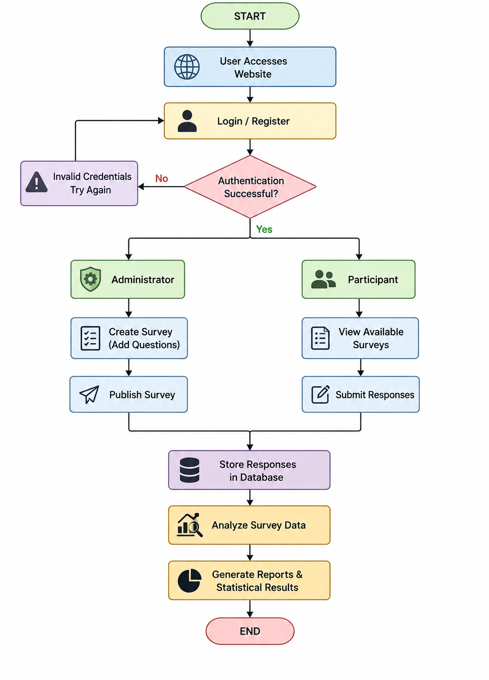
Flow Chart

Slide 5
Result:
Successfully created and deployed the survey application.
Enabled online survey creation and management.
Collected and stored responses securely.
Generated analytical reports automatically.
Improved efficiency in feedback collection.
Reduced manual effort and processing time.
Provided a user-friendly experience for administrators and participants.

Slide 6
Conclusion:
The Online Survey System with Analysis provides an efficient and user-friendly platform for creating surveys, collecting responses, and analyzing data.
The project successfully automates the survey management process, reducing manual effort and improving data accuracy.
It enables organizations, educational institutions, and businesses to gather feedback quickly and make informed decisions based on analytical reports.
The system ensures secure data storage and efficient response management through a centralized database.
Real-time data analysis and reporting help users gain meaningful insights from collected responses.
The application is accessible online, allowing users to participate in surveys from any location.
Final Outcome
A reliable and scalable Online Survey System capable of efficiently managing surveys, collecting responses, and generating meaningful analytical insights to support better decision-making.

